Slide 1





Home
Assignment
Step 4
Presented by: Group B

Slide 2

Overview
Roadmap
The Data
Classification
Regression
Model Performence
Financial Potential Analysis
Note potential issues

Slide 3







ROAD MAP
WEEK 0-2
WEEK 2-4
WEEK 4-6
WEEK 6-8
WEEK 8-10
WEEK 10-12
Business Understanding
Data Understanding/Data Preparation
Data Preparation/Modeling
Model selection and setup
Modeling/Evaluation
Evaluation/Deployment

Slide 4
Overview
Roadmap
The Data
Classification
Regression
Model Performence
Financial Potential Analysis
Note potential issues

Slide 5






Recap Data Available
Number of instances
Features
snap 2018
snap 2019
Number of instances
Features
-30.4%
expired_2019

Slide 6
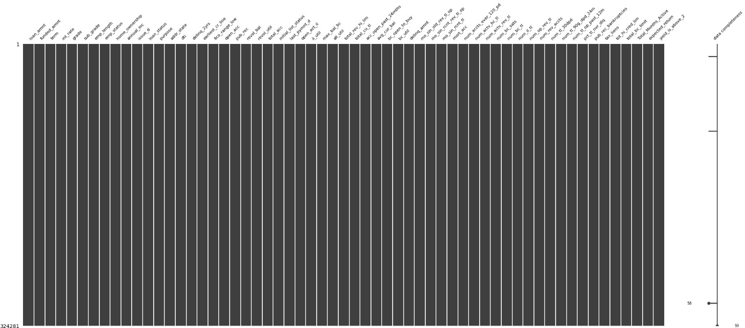
The Data
Features: 62
Instances: 322,980

Slide 7
Overview
Roadmap
The Data
Classification
Regression
Model Performence
Financial Potential Analysis
Note potential issues

Slide 8
Model Selection
1. Binary Variable:
Above 2% yield
Classification
2. Continuous Variable: Expected Return- each loan
Regression
Next step- combining consideration

Slide 9
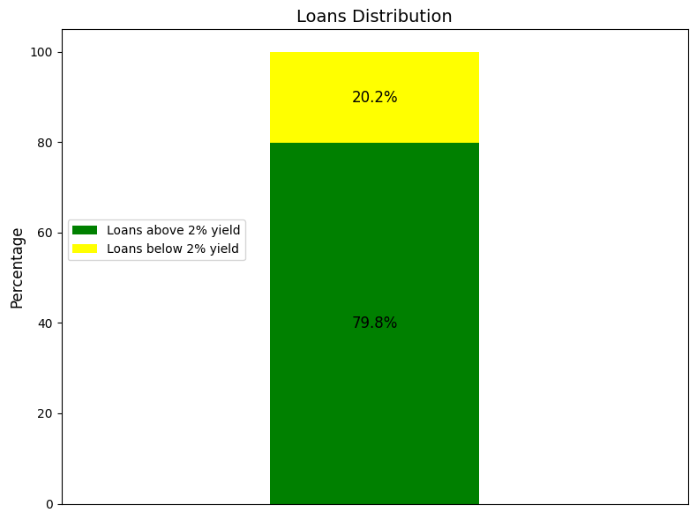
Classification
Data Distribution
loan yield above/under 2%

Slide 10
Classification
Models: Logistic Regression, AdaBoost, XGBoost
Feature Selection: Sequential feature selection tailored for each model
Next Step: correlation coefficients & p-values
Set a significance threshold.

Slide 11
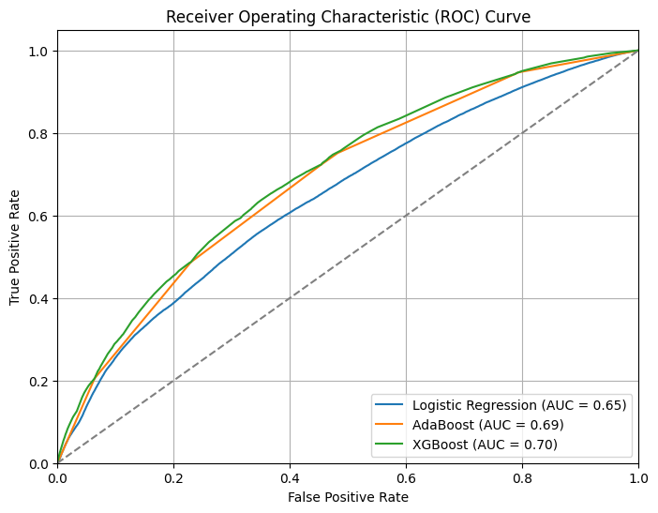
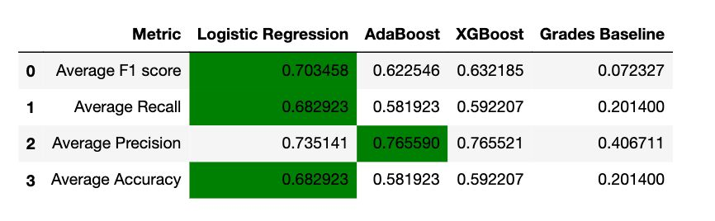
Classification Models
Evaluation Metrics

Slide 12
Overview
Roadmap
The Data
Classification
Regression
Model Performence
Financial Potential Analysis
Note potential issues

Slide 13
Model Selection
1. Binary Variable:
Above 2% yield
Classification
2. Continuous Variable: Expected Return- each loan
Regression
Next step- combining consideration

Slide 14
Regression Models
Models : 5 regression models, 4 variants of linear regression (Linear, Lasso, Ridge and Huber), Random Forest
Feature Selection: Sequential feature selection, 16 features
Model Selection and Hyperparameters: Tuning parameters

Slide 15
Regression
Evaluation Metrics
Metrics Used: MSE, R²
Model Results:
Linear, Lasso, Ridge similar (MSE 0.1103, R² 0.2510)
Huber higher MSE (0.1308)
Random Forest best performance (MSE 0.1099, R² 0.2538)

Slide 16
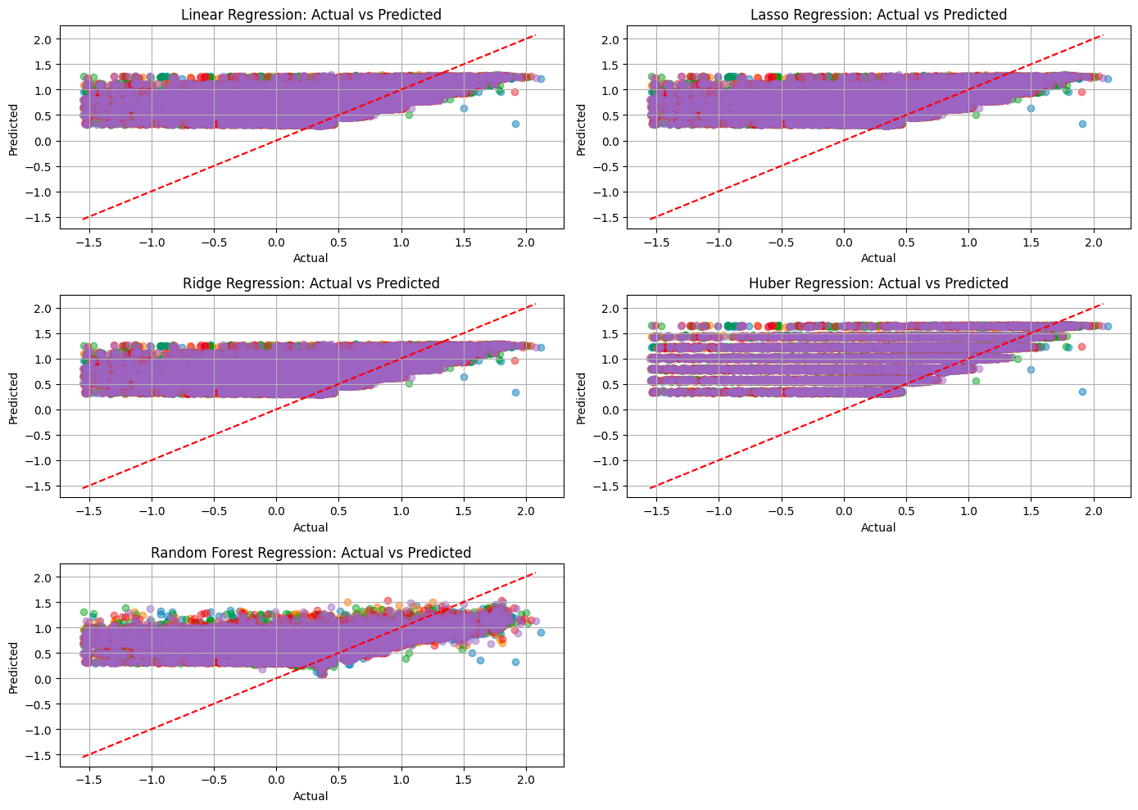
Regression
Evaluation Metrics

Slide 17
Overview
Roadmap
The Data
Classification
Regression
Model Performence
Financial Potential Analysis
Note potential issues

Slide 18
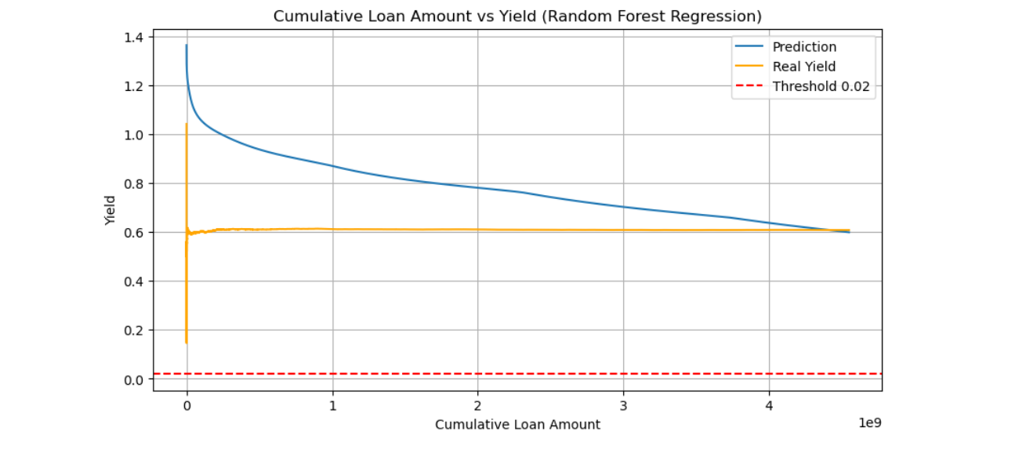
Financial Potential Analysis

Slide 19
Overview
Roadmap
The Data
Classification
Regression
Model Performence
Financial Potential Analysis
Note potential issues

Slide 20
main Pitfalls
Insufficient Consideration of Factors Beyond Yield:
*basing our regression predictions on the classification results
*probability and risk of a loan not yielding over 2% (?)
Ignoring market dynamics and external factors

Slide 21


CASCADING - Y / N ?
COMING UP NEXT.....
FINE TUNING & TESTING
Step 5- Modeling / Evaluation
EVALUATION

Slide 22


Thank you :)

